Slide 1
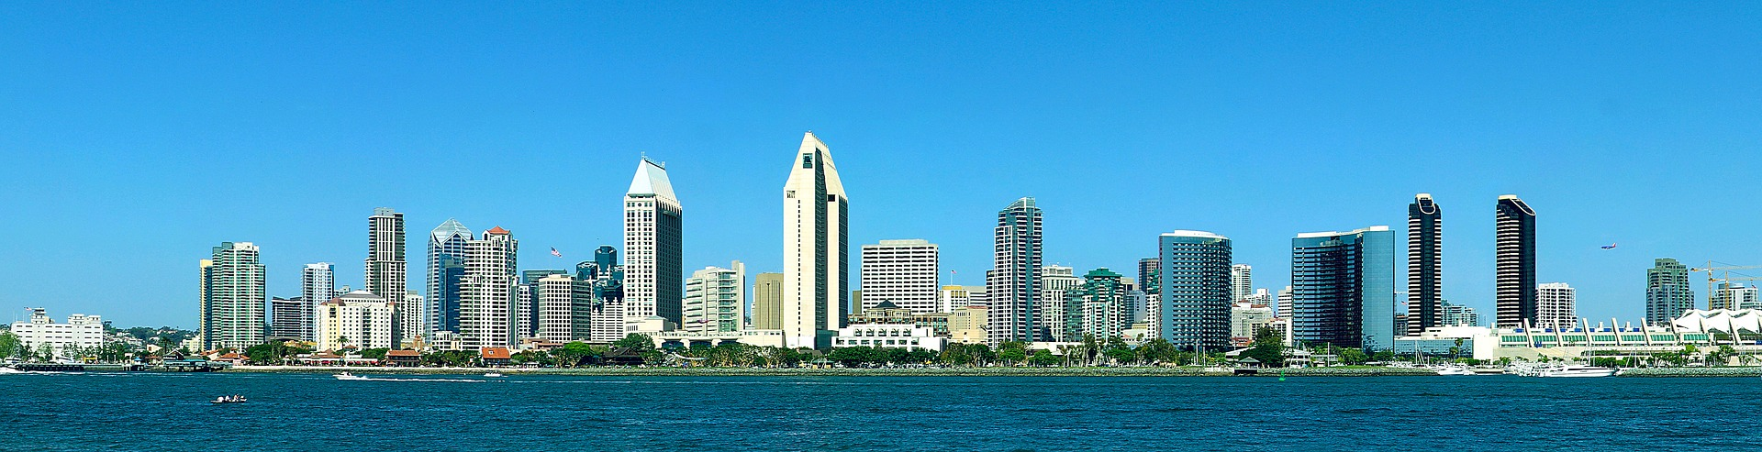
WhereSIOUS - San Diego
Where Should I Open Up Shop?
Jeffrey Silverman

Slide 2
WhereSIOUS - San Diego
Where Should I Open Up Shop?
Jeffrey Silverman
Should my new flower shop go here?
Or is this a better place for my flower shop?
Notes:
The City of San Diego wants to use *data* to improve things.
Specifically, using information about different neighborhoods in SD and how well businesses have done there in the past, I can predict the place where businesses will be most successful.
SHOW DEMO: SD Convention Center, code=45 (florist), then all of SD map

Slide 3
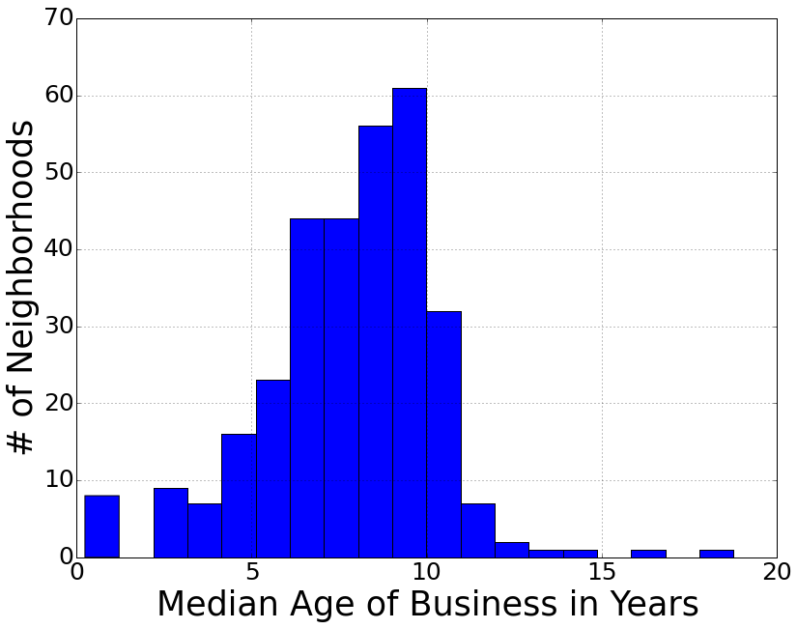
Longevity == Business Success
typical business age ≈ 8 years
56,707 businesses in 313 neighborhoods
Notes:
After discussions with SD officials, including people in the Data Office and the Business Development Office, we decided, given the dataset, that a good measure of a business’ success is how long it’s been around.
So I took the list of all current businesses in SD and calculated the median age of all businesses in each neighborhood (census tract).

Slide 4




From Data to WhereSIOUS Score
Notes:
I get business age & location and type of business from the City of SD data portal.
I get population, housing, income, and employment data from the census and walk/bike/transit scores from walkscore.com

Slide 5
From Data to WhereSIOUS Score
clean data & describe each neighborhood and their businesses

Slide 6
From Data to WhereSIOUS Score
clean data & describe each neighborhood and their businesses
linear regression with input data & business ages

Slide 7
From Data to WhereSIOUS Score
clean data & describe each neighborhood and their businesses
predict business age (and scale it to calculate WhereSIOUS score) for each neighborhood
linear regression with input data & business ages

Slide 8

From Data to WhereSIOUS Score
output WhereSIOUS score(s) & Google Map to website!
clean data & describe each neighborhood and their businesses
predict business age (and scale it to calculate WhereSIOUS score) for each neighborhood
linear regression with input data & business ages

Slide 9
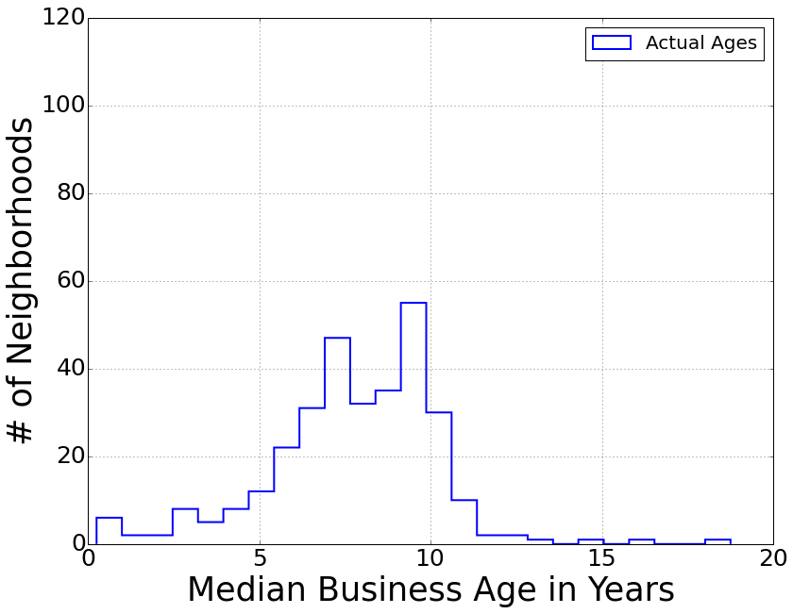
Validation
Notes:
My predicted range of ages is narrower than the input, which is good since the neighborhoods with really high and really low median all have very few businesses in them (i.e., small number stats) so they aren’t very trustworthy for the model.
7x better than just using # of businesses in each neighborhood
r^2 = 0.152; BIC = -355; AIC = -404; 12 features used

Slide 10
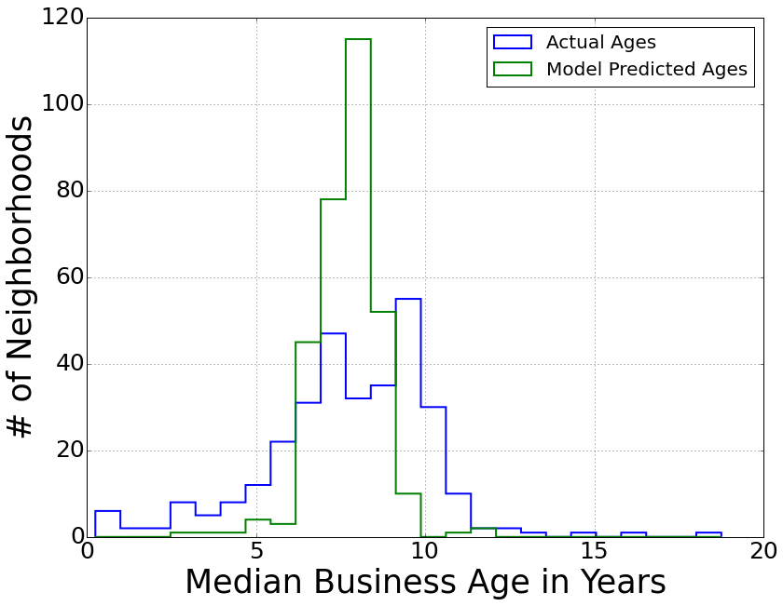
Validation
Model “corrects”
outlier neighborhoods
Notes:
My predicted range of ages is narrower than the input, which is good since the neighborhoods with really high and really low median all have very few businesses in them (i.e., small number stats) so they aren’t very trustworthy for the model.
7x better than just using # of businesses in each neighborhood
r^2 = 0.152; BIC = -355; AIC = -404; 12 features used

Slide 11
Validation
Model “corrects”
outlier neighborhoods
Typical prediction error (RMSE) of ~2 years
Notes:
My predicted range of ages is narrower than the input, which is good since the neighborhoods with really high and really low median all have very few businesses in them (i.e., small number stats) so they aren’t very trustworthy for the model.
7x better than just using # of businesses in each neighborhood
LOOCV = 1.7 yr; RMSE = 2.3 yr
r^2 = 0.152; BIC = -355; AIC = -404; 12 features used

Slide 12
SD State University & Qualcomm Stadium
Notes:
Here’s another part of SD, again color-coded by WhereSIOUS score (for all businesses).
This is SDSU and the mostly residential areas just east of it, which aren’t great for businesses since there tends to be lots of turnover near universities.
Whereas, along the 8, 15, and 805, and near Qualcomm Stadium are pretty good neighborhoods for businesses.

Slide 13



Successful Businesses Tend to be in Neighborhoods with:
More businesses
Higher percent female population
Higher median age
Notes:
n_business 0.2621+/-0.083 (3 sigma; P>|t|=0.002)
percent_female 0.2427+/-0.093 (2.5 sigma; P>|t|=0.010)
age_med 0.1771+/-0.078 (2 sigma; P>|t|=0.024)

Slide 14
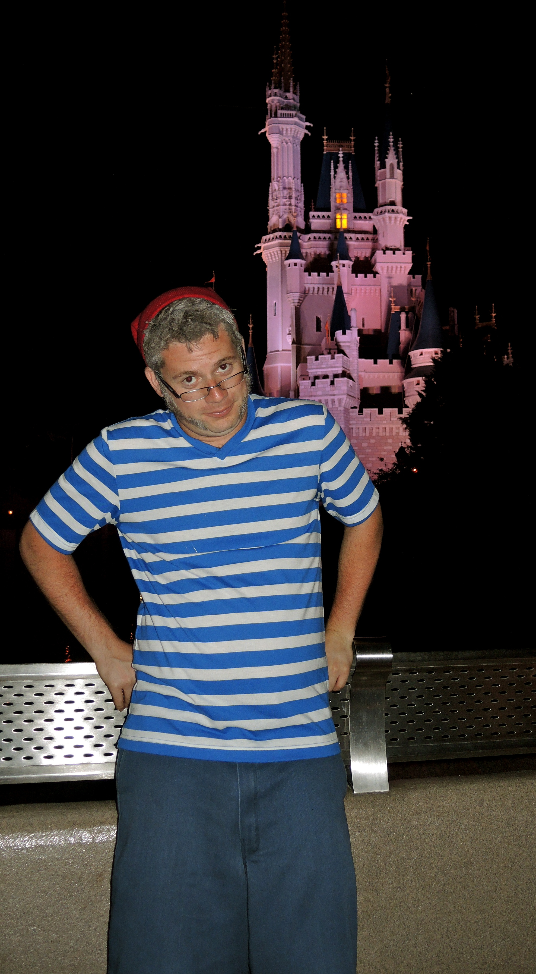

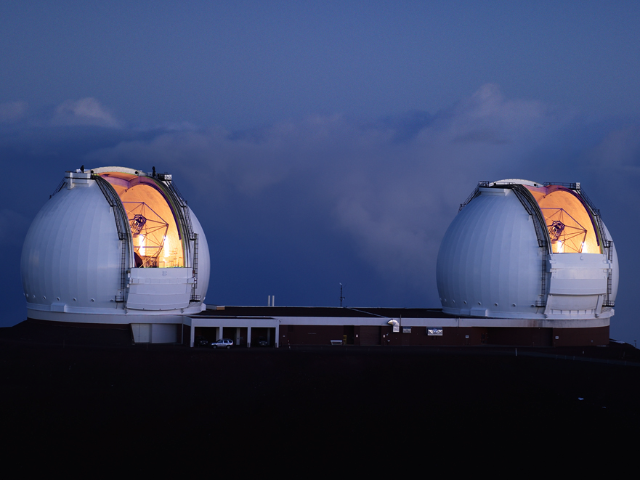

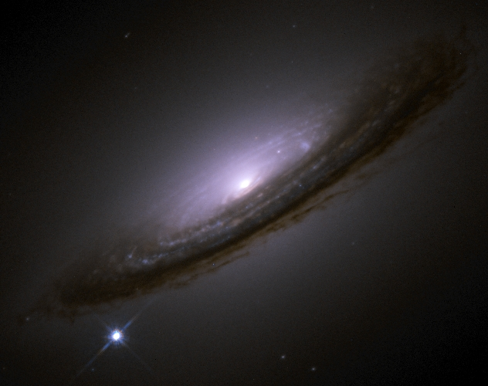
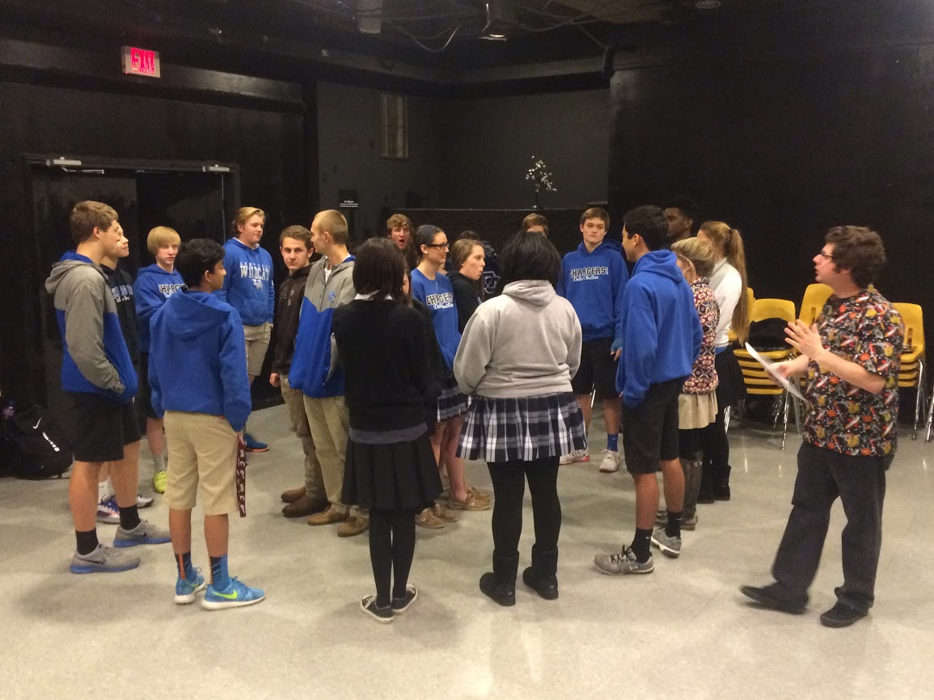
Jeffrey Silverman

Slide 16
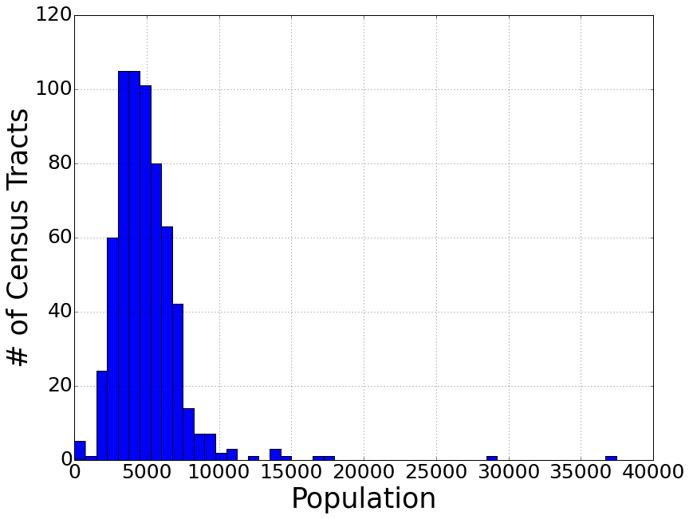
Neighborhoods (i.e., Census Tracts)
average population
per census tract ≈ 4930
Notes:
Census tracts are subdivisions used by the US Census.
There are supposed to be about 5000 people in each census tract, which seems to be true for the city of SD.
Of course this means that there’s a wide range in the physical sizes of different census tracts with very sparsely populated tracts being physically much larger.
This is the resolution of my model, in other words, I predict how successful a business will be in a given census tract.

Slide 17
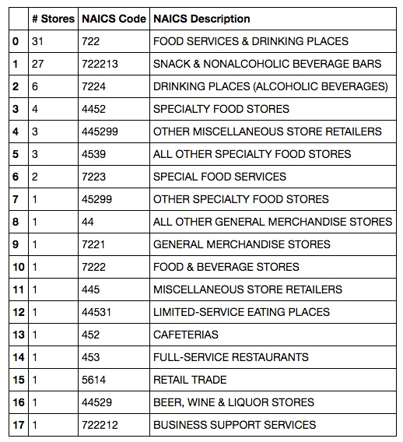

Business Info – NAICS (North American Industry Classification System)
Notes:
NAICS has a bunch of numeric codes to describe various industries, so hopefully I can use this to identify different business types and how they perform in different locations.
Each business has a single code, but they’re not super unique and very similar businesses have different codes!
For example, Starbucks has 87 locations in SD with 18 different NAICS codes!
Their numbering system has the first two-digits as the most general category and then more digits refine the classification (i.e., 722, 7224, 722213).
I could just use the codes as-is, but it seems silly that we have 18 different “types” of Starbucks.
So I took the first two digits, which are the top-most level in the classification hierarchy.

Slide 18
Business Info – NAICS (North American Industry Classification System)
4 “simple” codes
79% are Code 72
13% are Code 44
Notes:
This method turns this list into 4 different codes for all Starbucks, with 79% of them sharing the same code (72), 13% with a second code (44)

Slide 19
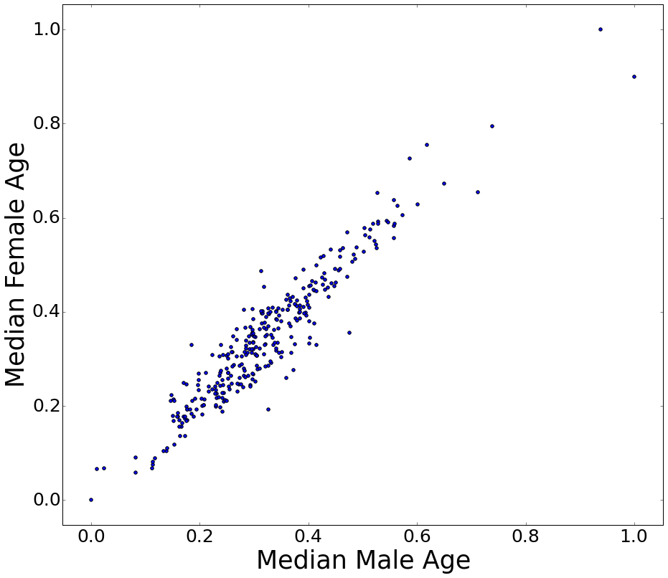
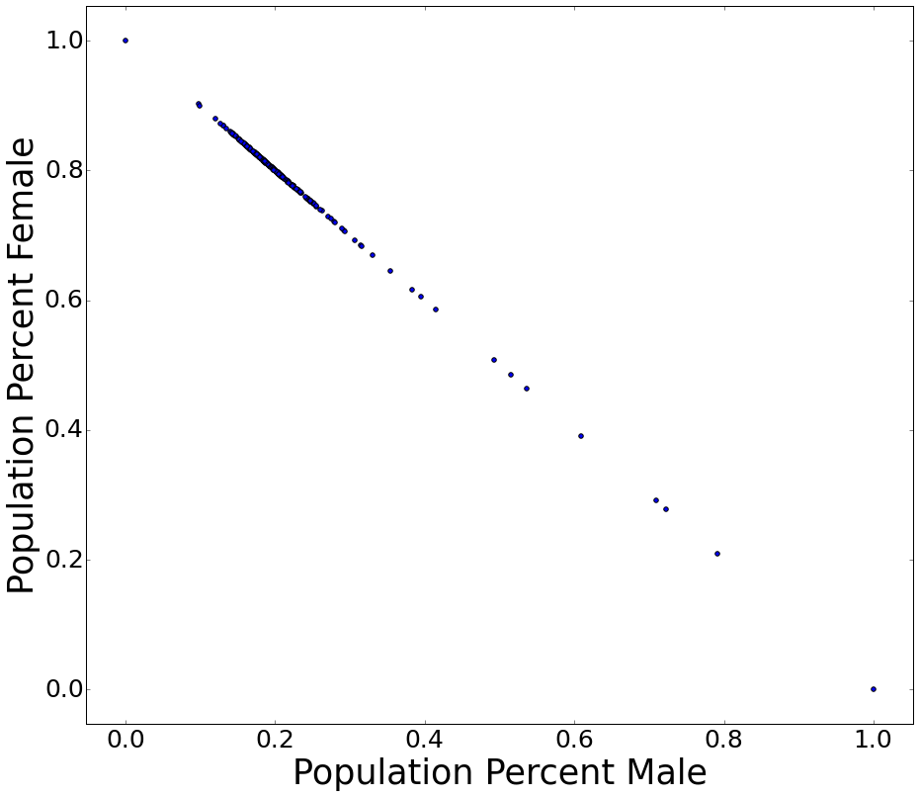
Fun With Census Data!

Slide 20
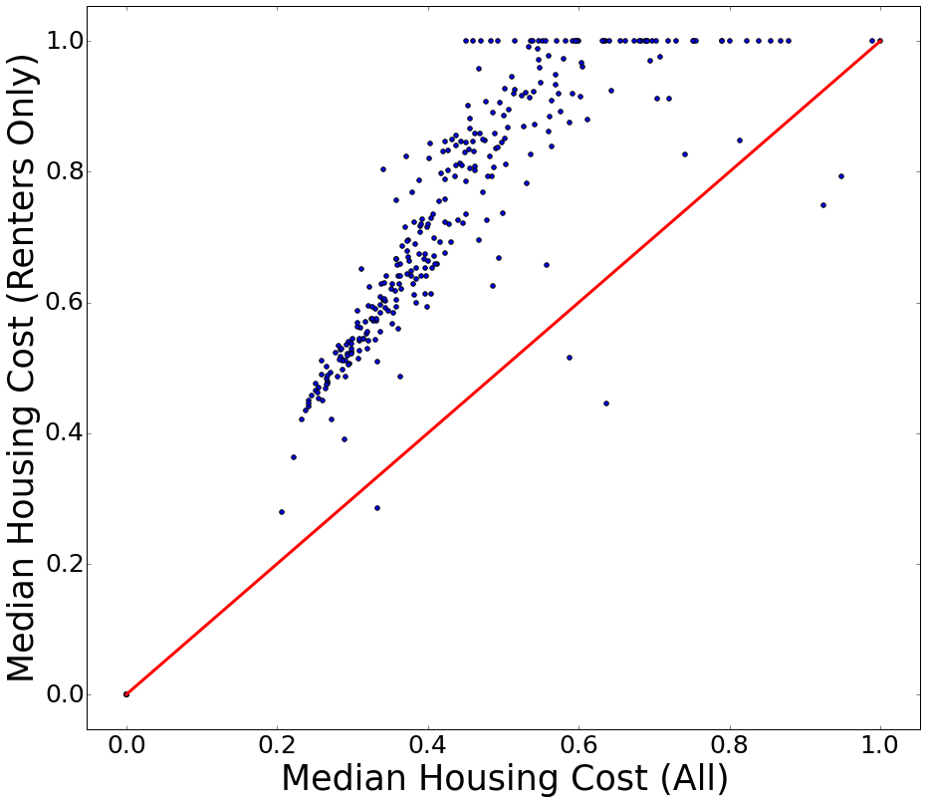
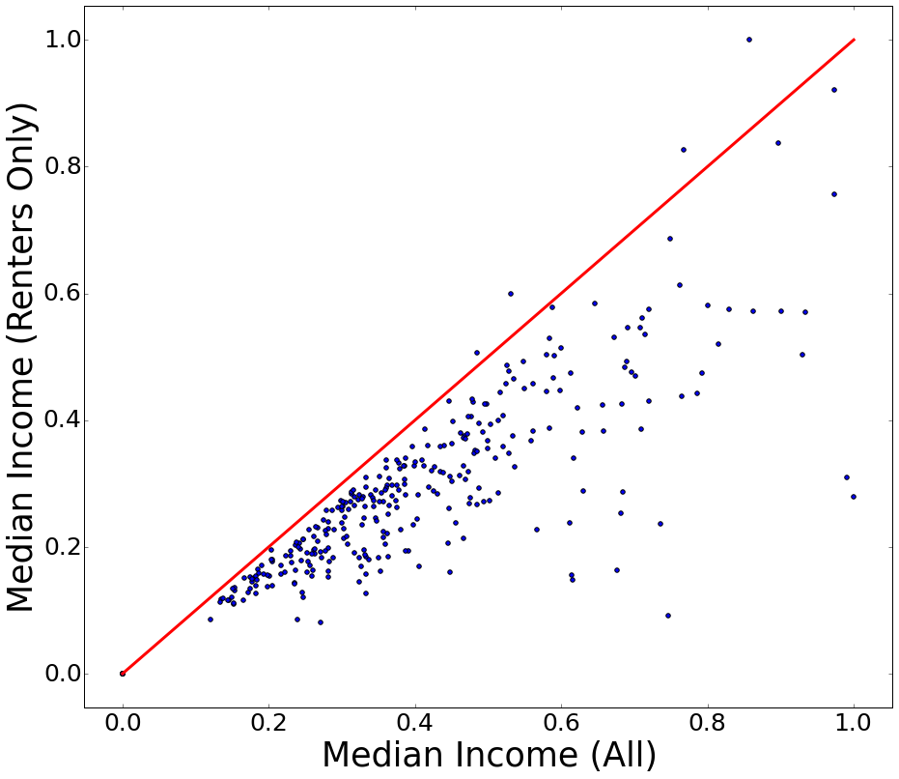
Fun With Census Data!

Slide 21
Features Used (12)
Total # of businesses (3σ)
Percent female population (2.5σ)
Median age (2σ)
Walk score (1.5σ)
Bike score (1.5σ)
Percent adult population (1.5σ)
Median income (1σ)
Total population
Total # of homes
Employment percentage
Median housing cost
Transit score

Slide 22

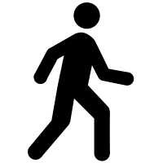


Successful Businesses Tend to be in Neighborhoods with:
More businesses
Higher percent female population
Higher median age
Lower “bike score” (?!)
Higher “walk score”
Higher percent adult population
Higher median income
X
Notes:
walk_score 0.1672+/-0.102 (1.5 sigma; P>|t|=0.103); bike_score -0.1288+/-0.079 (1.5 sigma; P>|t|=0.105)
adult_percent 0.1488+/-0.107 (1.5 sigma; P>|t|=0.167); income_med 0.1224+/-0.108 (1 sigma; P>|t|=0.259)
Walk score is calculated based on walking distance to businesses and pedestrian friendliness (e.g., block length and intersection density, but NOT hilliness).
Bike score is based on number of bike lanes, hilliness of an area, road connectivity, and the number of bike commuters. So with some hills and not many bike commuters, bike scores are relatively low in much of SD and *might* be lower near more successful businesses.
And bike score and walk score are fairly strongly correlated!

Slide 23
Features Used (12)
-main model uses all businesses, allowing all tracts to be used
-made 8 other models, using same features, but only using businesses of top 8 codes
-78% of businesses have the top 8 (of 24) codes
-40% of businesses have the top 2 (of 24) codes
-24% of businesses have the top 1 (of 24) codes

